Slide 1
CYDNEY CHELANGAT
C027-01-1147/2021

Slide 2
EVIDENCE OF HAVING RELEVANT PROFESSIONAL SOCIAL MEDIA PLATFORM SOCIAL MEDIA
social media platform is an online service or application that facilitates interaction and sharing of content among users. These platforms allow individuals and organizations to create profiles, share information, connect with others, and communicate through various formats such as text, images, videos, and more.

Slide 3
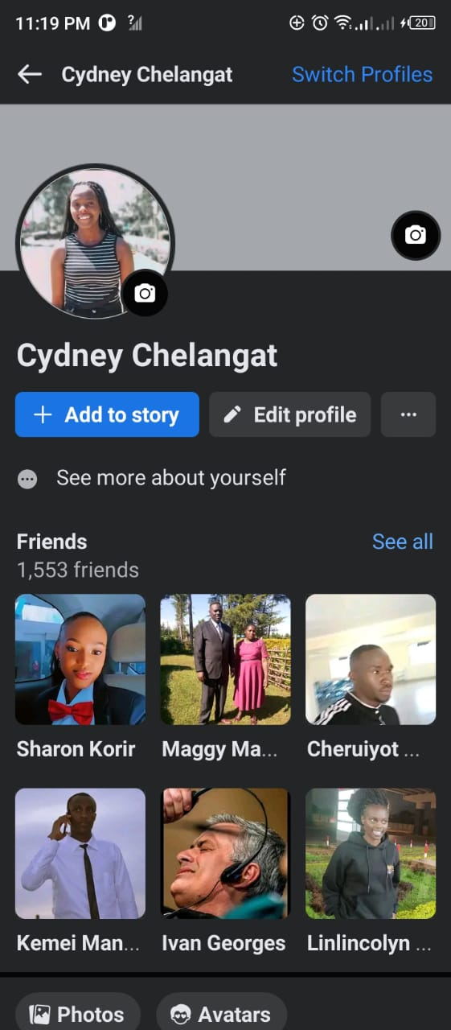
FACEBOOK
Founded by Mark Zuckerberg, Facebook is a social networking platform that allows users to create profiles, share updates, photos, videos, and connect with friends, family, and communities through posts, comments, and messages.

Slide 4
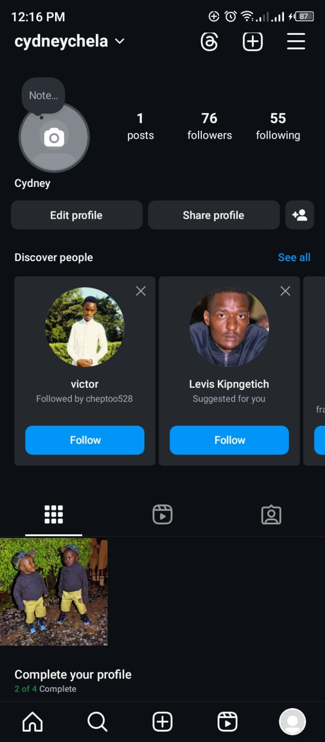
INSTAGRAM
Instagram is a visual social media platform primarily focused on photo and video sharing. Users can post images and short videos, add captions, use hashtags, follow other users, and engage through likes, comments, and direct messages.

Slide 5

TWITTER
Twitter is a microblogging platform where users can post short messages called "tweets." These tweets can include text, images, videos, and links, and they are visible to followers. Twitter is known for its real-time information sharing and interaction.

Slide 6
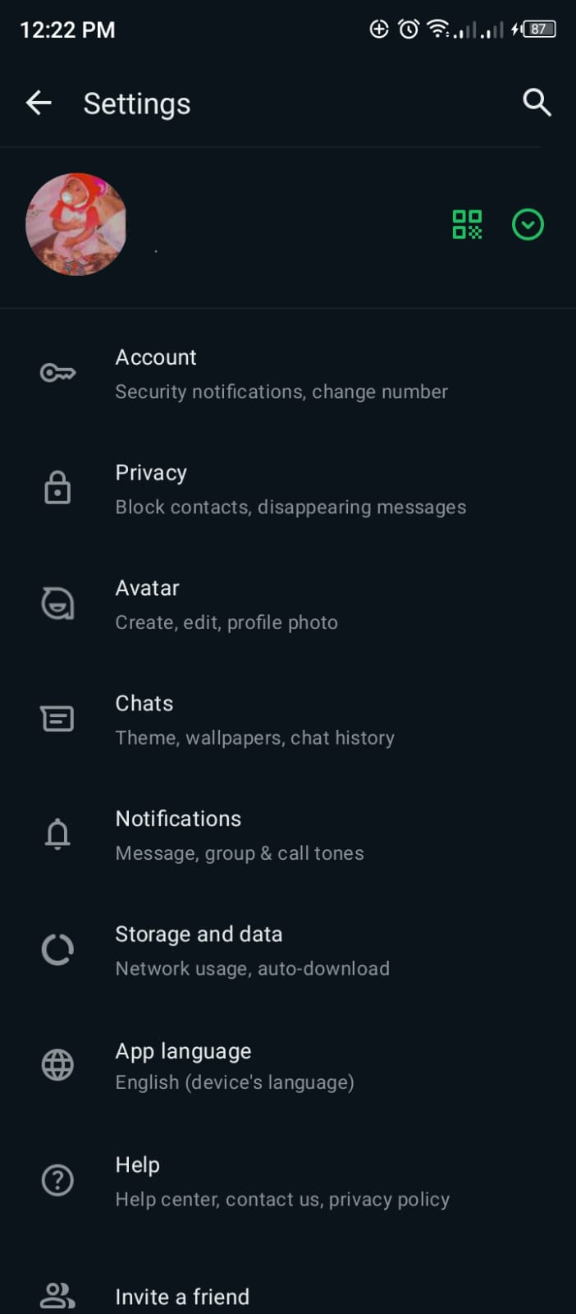
WHATSAPP
WhatsApp is a messaging application that enables users to send text messages, make voice and video calls, share media, and create group chats. It focuses on private and secure communication between individuals or groups.

Slide 7

LINKEDLN
LinkedIn is a professional networking platform designed for career development, networking, and business-related activities.

Slide 8
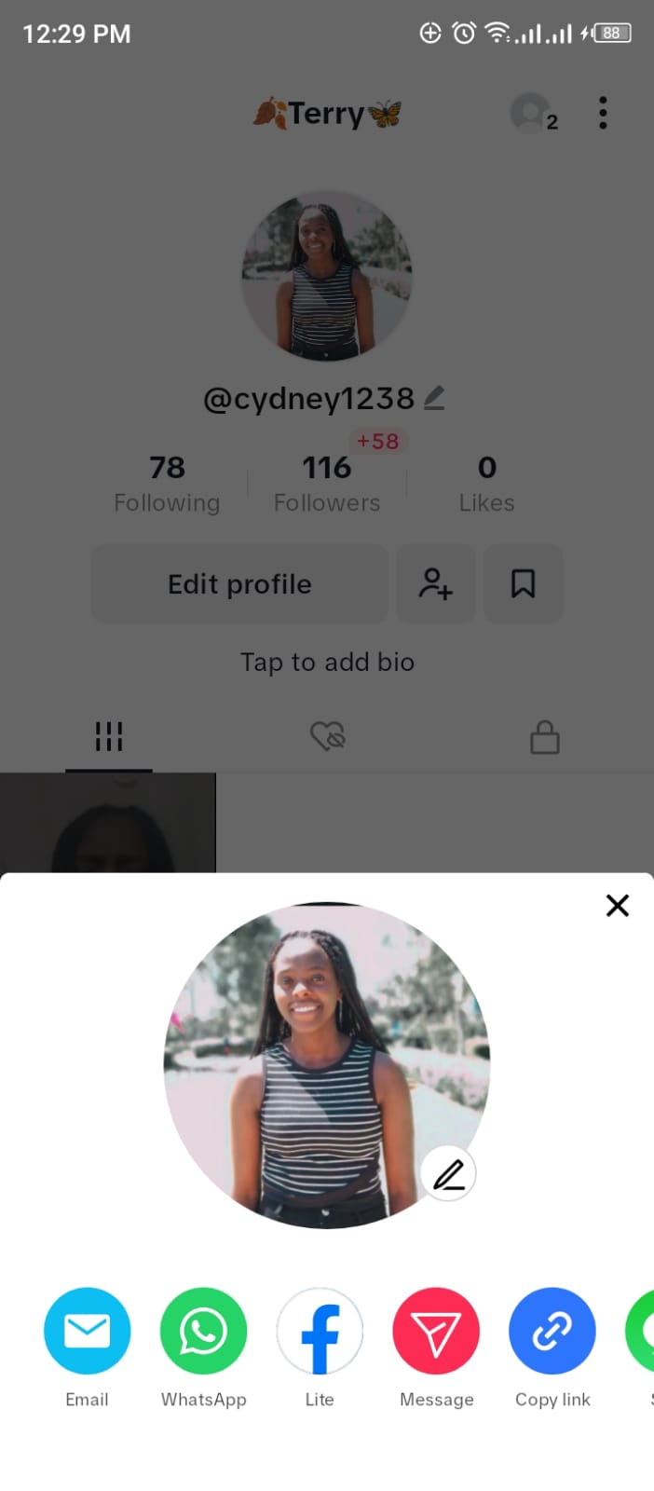
TIKTOK
A video-sharing app where users can create short videos set to music or sound bites. It gained popularity for its short-form, entertaining content and allows users to add effects, filters, and collaborate with others.

Slide 9
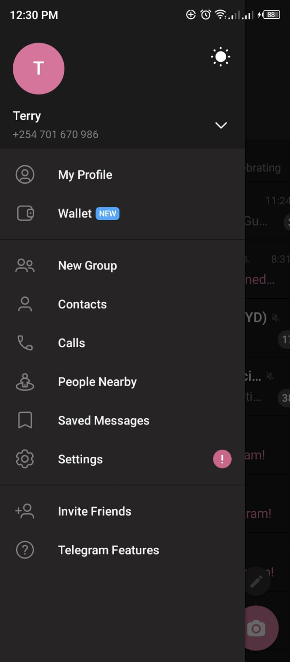
TELEGRAM
Telegram is a cloud-based instant messaging app designed to provide fast, secure, and versatile communication. It allows users to send text messages, voice messages, photos, videos, and files of any type, supporting both individual and group conversations. One of Telegram's standout features is its strong emphasis on security and privacy, offering end-to-end encryption for Secret Chats, self-destructing messages, and two-step verification to protect user data.

Slide 10
THANKYOU!!

